Slide 1
Live coding competition
Can you code??

Slide 2
Web Page for NTC.

Slide 3


Developed By
Bishal Thapa Magar
Bharat Bohara
Nirmal Rokamagar

Slide 4
Programming Language is used
HTML & CSS (limited)

Slide 5
Characteristics

Slide 6
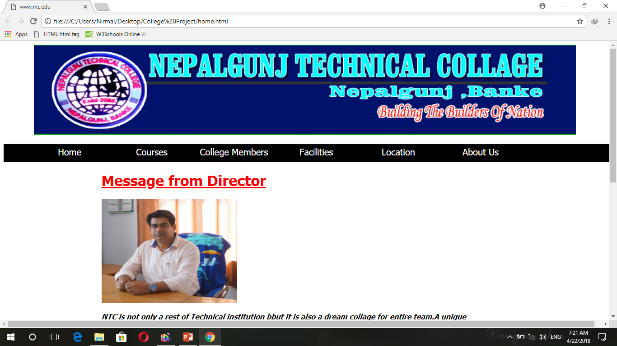
1. Home Page

Slide 7
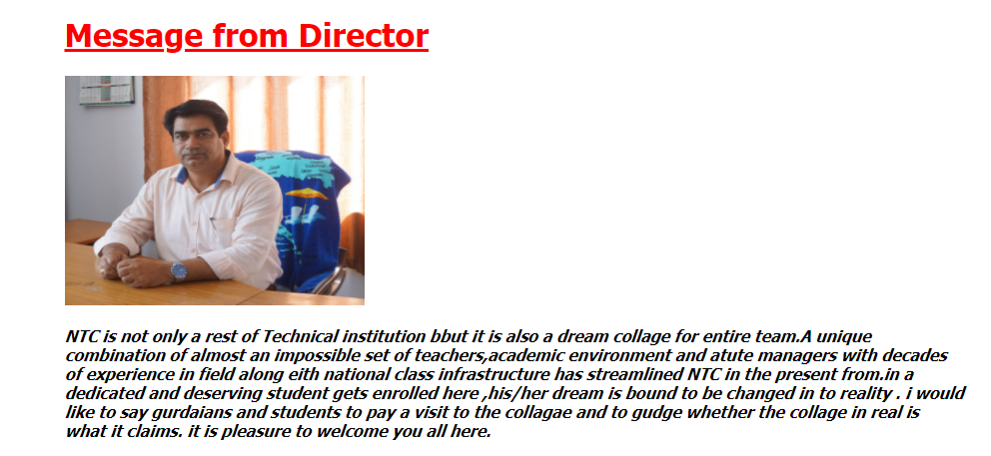
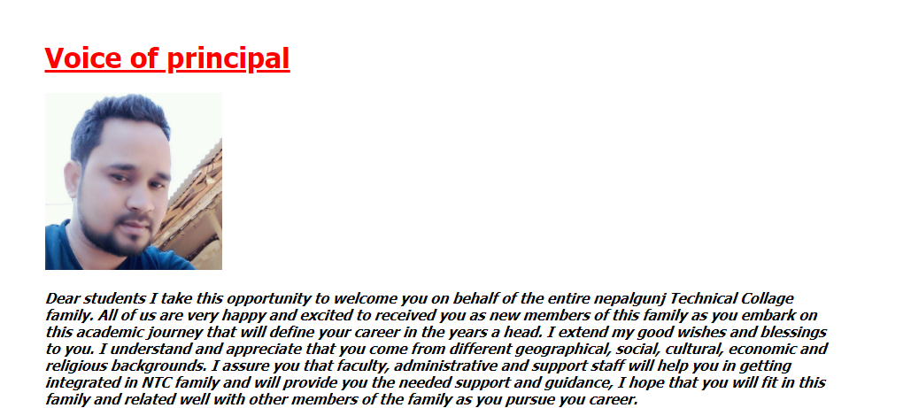
Some words from Principle & founder

Slide 8
2. No
Courses

Slide 9
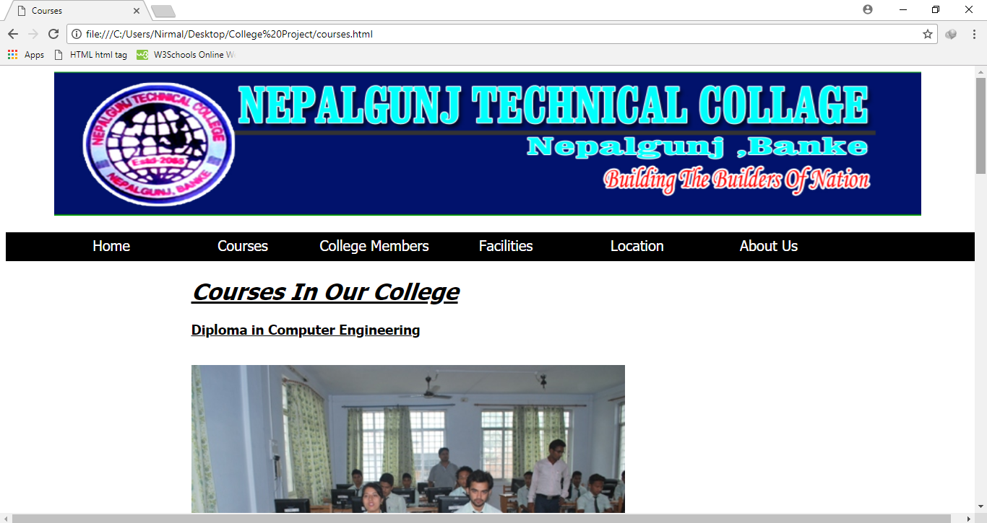
Page Courses

Slide 10
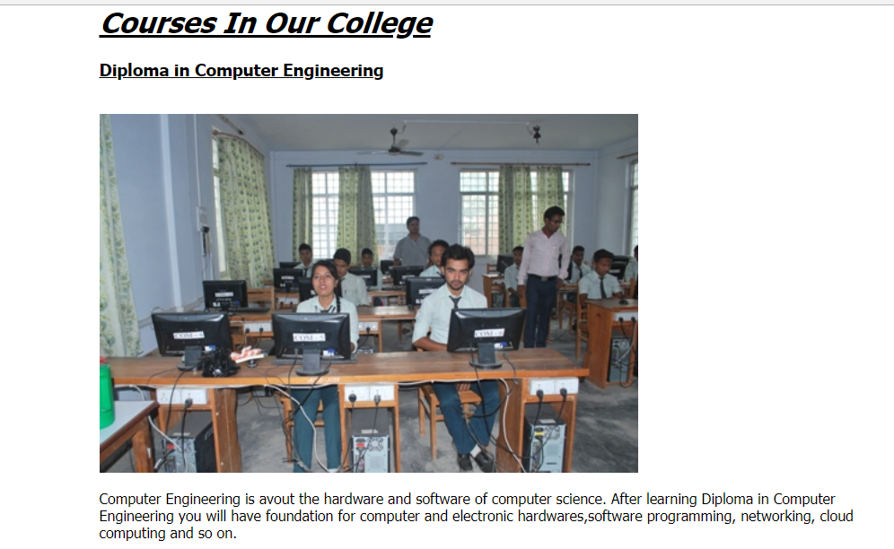
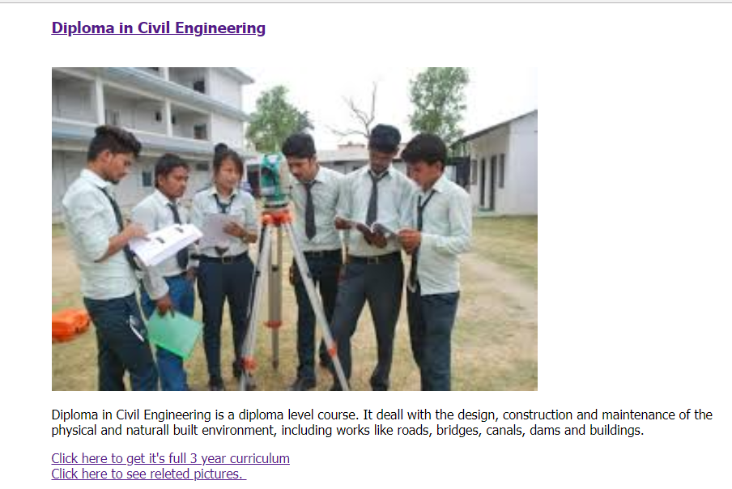
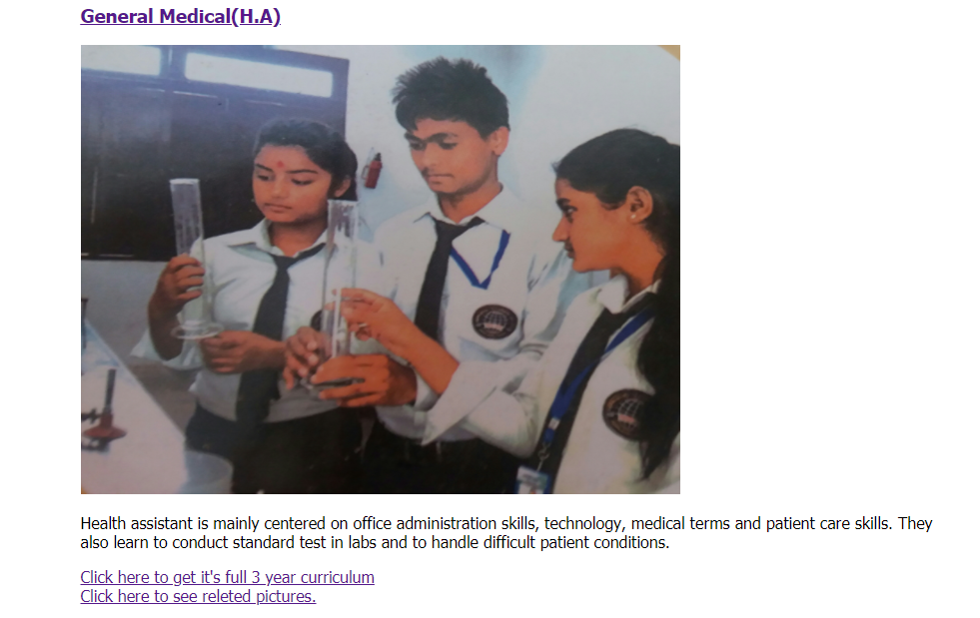
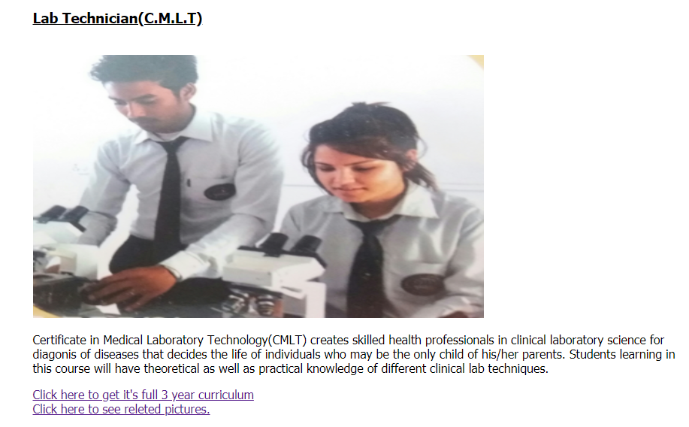
Courses

Slide 11

We Can download & see here syllabus & Pictures related Courses

Slide 12
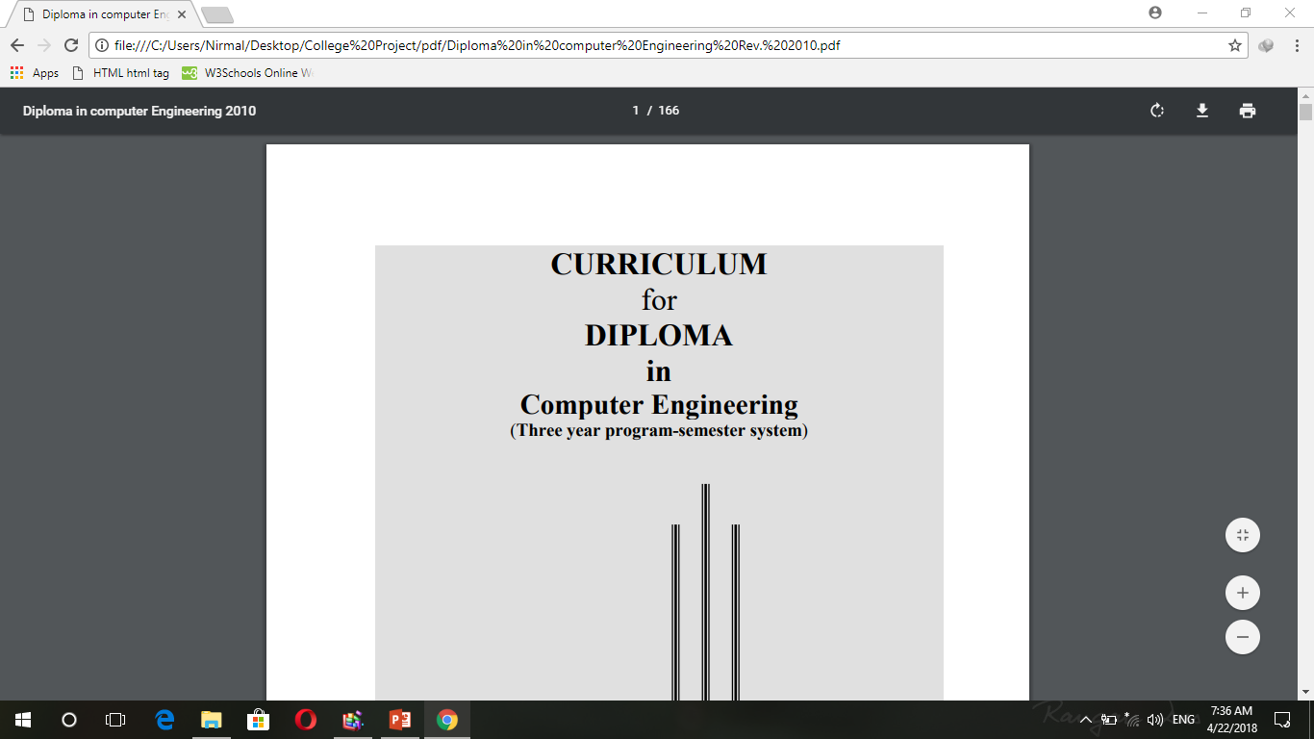
Sample

Slide 13
3. No
College Members

Slide 14
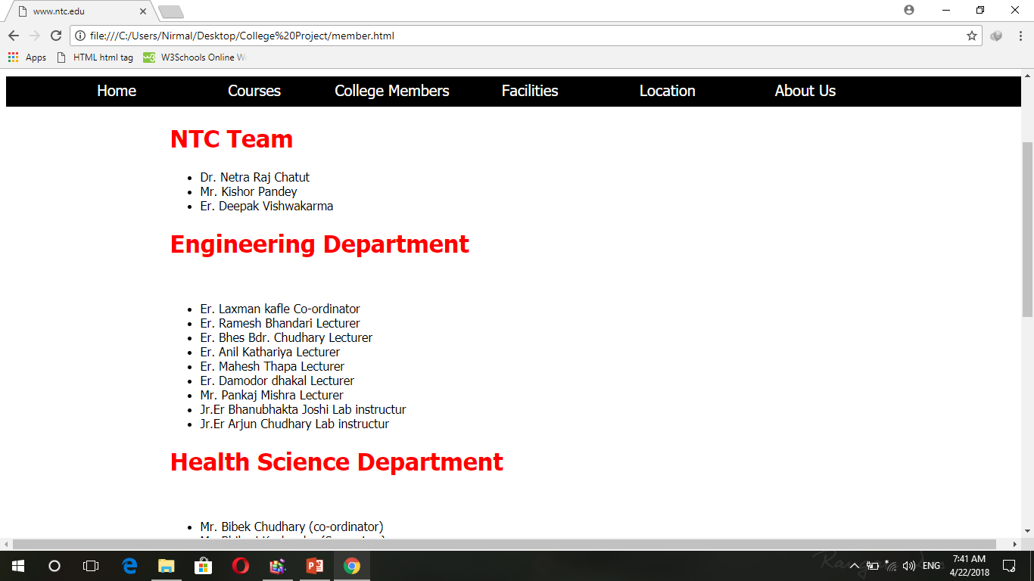

Slide 15
4. No
Facilities

Slide 16
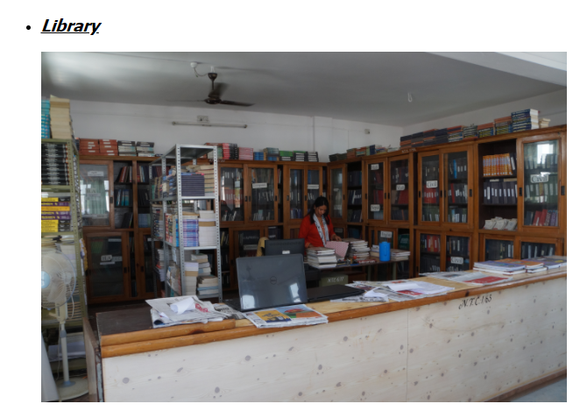

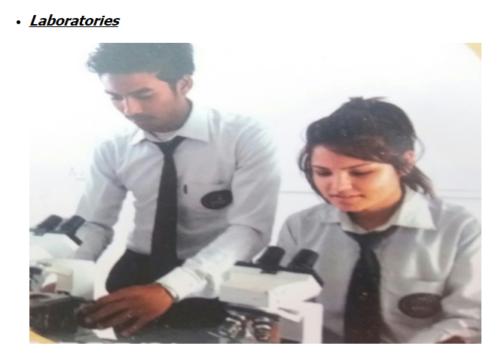
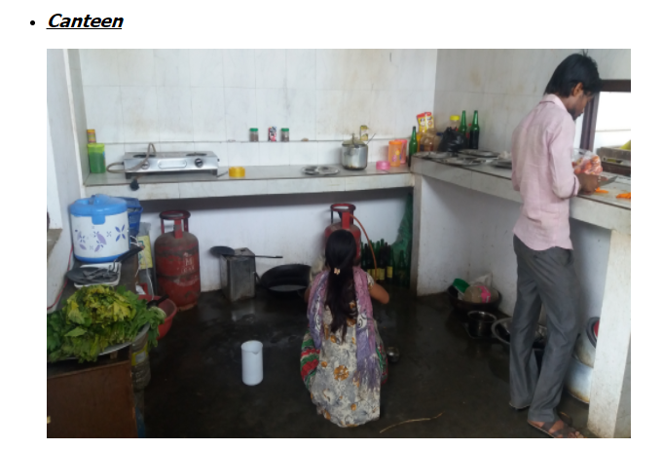

Slide 17
4.No
College Location

Slide 18
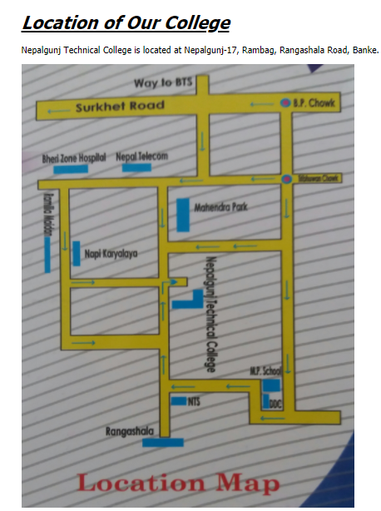

Slide 19
5.No
About US

Slide 20
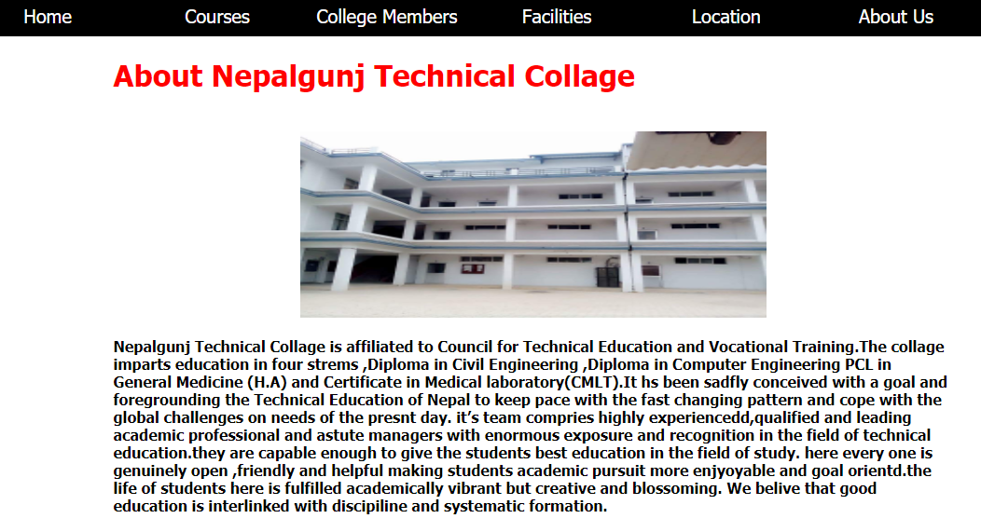

Slide 21
Future features

Slide 22

Name:-Er. Ashis Chataut
Age:-25 year
Engineering Department
Lecturer
College:-Nepalgunj Technical College
Graduation:-Dharan Engineering College
Er. Ashis Chataut

Slide 23
Other Features
Online admission and payment
Events and Notices on webpage such as projects, exam routines, etc
Result publication on college webpage
Details of all students through students database
Use of CSS, java script and PHP for better appearance and features of college webpage

Slide 24

Sources
Web Pages
Class NOTES

Slide 25

Special Thanks

Slide 26
THE END

Slide 27
Any Queries?

